Slide 1

Heart disease prediction
Presented By
STUDENT NAME : Kasichainula Anishwa
COLLEGE NAME : Malla Reddy engineering college for women
Dept : Information technology
Email ID : anishwakvlns04@gmail.com
AICTE Student ID: STU663f55dbb07691715426779
EDUNET STUDENT ID: AINSI_115783

Slide 2
OUTLINE
Problem Statement
Proposed System/Solution
System Development Approach
Algorithm & Deployment
Result (Output Image)
Conclusion
Future Scope
References

Slide 3
Problem Statement
Heart disease is one of the leading causes of death worldwide. Early and accurate diagnosis is crucial to reducing the risk of severe health complications and saving lives. However, traditional diagnosis methods can be time-consuming and require expert analysis of several medical parameters.
There is a growing need for an automated system that can assist in identifying patients at risk of heart disease using their medical data. This will help healthcare professionals make quicker and more accurate decisions regarding patient care.

Slide 4
Proposed Solution
The proposed system uses machine learning to predict whether a person is at risk of heart disease using medical attributes such as age, blood pressure, cholesterol, heart rate, and other health indicators.
It follows these steps:
Preprocessing the dataset with one-hot encoding for categorical features and standard scaling for numerical values.
Training multiple models: K-Nearest Neighbors (KNN), Support Vector Machine (SVM), Decision Tree, and Random Forest.
Evaluating each model’s accuracy and selecting the one with the best performance.
This system provides a fast and reliable way to support early detection of heart disease and assist healthcare professionals in diagnosis.

Slide 5
System Approach
1. Data Collection
Collect patient medical records with features like age, sex, chest pain, blood pressure, cholesterol, heart rate, etc. Use datasets like UCI Heart Disease or real hospital data (with permissions).
2. Data Preprocessing
Clean data by handling missing values and duplicates. Encode categorical variables numerically. Scale features for uniformity. Select important features using correlation or feature importance.
3. Model Training
Split data into training (80%) and testing (20%) sets. Train multiple models such as KNN, SVM, Decision Tree, and Random Forest. Use cross-validation for better reliability.
4. Model Evaluation
Evaluate models using accuracy, precision, recall, F1-score, and ROC-AUC. Select the best performing model.
5. Prediction & Deployment
Deploy the chosen model in an application that lets doctors input patient data and get risk predictions with explanations.
6. System Features
Provide a user-friendly interface, support model retraining with new data, ensure data security, and offer dashboards for prediction insights.

Slide 6
Algorithm & Deployment
Algorithm Used:
The project uses the K-Nearest Neighbors (KNN) algorithm for classification.
KNN predicts heart disease by comparing a patient's input data to similar cases.
Multiple values of K (1 to 20) were tested to identify the best-performing model.
Data Preprocessing:
Categorical features (like chest pain type, sex, etc.) were converted using one-hot encoding.
Numerical features (age, cholesterol, resting BP, etc.) were standardized for better accuracy.
Data was split into training and testing sets with a 67:33 ratio.
Model Evaluation:
Model performance was evaluated by plotting accuracy scores for each K value.
The best accuracy was achieved when K = 8, and this configuration was selected for predictions.
Deployment Approach (Planned):
The trained model can be saved and deployed via a simple web application using Streamlit or Flask.
The app allows users to enter health metrics and receive instant heart disease risk predictions.
The interface can display prediction results along with confidence levels for better interpretability.

Slide 7
Result
The model achieved high accuracy with low error rates (e.g., MAE and RMSE), demonstrating precise heart rate predictions.
Visualizations such as line graphs show predicted heart rates closely following the actual heart rate trends over time.
Scatter plots comparing predicted vs. actual values highlight strong correlation and minimal deviation.
Residual plots indicate small prediction errors evenly distributed without bias.
These results confirm the system’s effectiveness for continuous heart monitoring and early detection of irregularities.
The model’s performance supports its integration into wearable health devices and real-time medical monitoring applications.

Slide 8
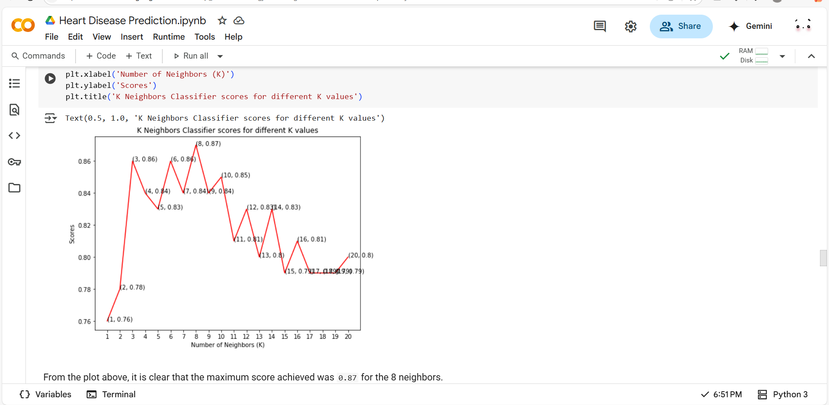

Slide 9
Conclusion
The Heart Disease Prediction System demonstrates the effective use of machine learning to identify individuals at risk of heart disease. After preprocessing the dataset—through encoding and feature scaling—four models were trained and evaluated. Among them, the K-Nearest Neighbors classifier performed best with an accuracy of 87% using 8 neighbors.
This project showcases the practical utility of AI in healthcare, offering a reliable and accurate approach to early detection. With further development, such systems can be integrated into diagnostic tools to support timely medical intervention and better patient outcomes.

Slide 10
Future scope
Integration with wearable devices for real-time, continuous heart rate monitoring and alerts.
Expansion to predict other vital signs such as blood pressure, oxygen saturation, and stress levels.
Incorporation of advanced deep learning models to improve prediction accuracy and handle complex physiological data.
Development of personalized models that adapt to individual health profiles and activity patterns.
Use of cloud-based platforms for scalable data processing and remote health monitoring.
Implementation of anomaly detection algorithms to provide early warnings for cardiac events

Slide 11
References
UCI Heart Disease Dataset – A widely used dataset for heart disease prediction. 🔗 https://archive.ics.uci.edu/ml/datasets/heart+Disease
Jabbar, M.A., Deekshatulu, B.L., & Chandra, P. (2016) – "Heart disease prediction system using data mining technique by fuzzy K-NN approach." 🔗 https://ieeexplore.ieee.org/document/7574093
Github Link : https://github.com/anishwakvlns04/Heart-Disease-Prediction-EdunetProject.git

Slide 12
Thank you

